Slide 1
Chapter 1: Roadmap
1.1 What is the Internet?
1.2 Network edge
1.3 Network core
1.4 Physical media
1.5 Internet structure and ISPs
1.6 Delay & loss in packet-switched networks

Slide 2
What’s the Internet:
Millions of connected computing devices: hosts or end systems running network apps
Internet: “network of networks”
loosely hierarchical
public Internet versus private intranet
Private intranet restrict the flow of messages to and from the network
Protocols: control sending, receiving of msgs
e.g., TCP, IP, HTTP, FTP, PPP
router
workstation
server
mobile
local ISP
regional ISP
company
network

Slide 3
What’s the Internet: “nuts and bolts” view
Communication links
Fiber, copper, radio, satellite
Transmission rate = bandwidth
Routers: forward packets (chunks of data)
ISP: provide a variety of different types of network access to the end systems
router
workstation
server
mobile
local ISP
regional ISP
company
network

Slide 4
Chapter 1: roadmap
1.1 What is the Internet?
1.2 Network edge
1.3 Network core
1.4 Physical media
1.5 Internet structure and ISPs
1.6 Delay & loss in packet-switched networks

Slide 5
A closer look at network structure:
Network edge: applications and hosts
Network core:
Routers
Network of networks
Access networks, physical media: communication links

Slide 6
The network edge:
End systems (hosts):
Run application programs
E.g. Web, email
At “edge of network”
Client/server model
Client host requests, receives service from ‘always-on’ server
E.g. Web browser/server; email client/server
Peer-peer model:
Minimal (or no) use of dedicated servers
E.g. Gnutella, kazaa

Slide 7
Network edge: connection-oriented service
Goal: data transfer between end systems
handshaking: setup data transfer ahead of time
Hello, hello-back human protocol
set up “state” in two communicating hosts
TCP - Transmission Control Protocol
Internet’s connection-oriented service
TCP service [RFC 793]
Reliable, in-order byte-stream data transfer
Loss: acknowledgements and retransmissions
Flow control:
Sender won’t overwhelm receiver
Congestion control:
Senders “slow down sending rate” when network congested

Slide 8
Network edge: connectionless service
Goal: data transfer between end systems
same as before!
UDP - User Datagram Protocol [RFC 768]:
connectionless
unreliable data transfer
no flow control
no congestion control
App’s using TCP:
HTTP (Web), FTP (file transfer), Telnet (remote login), SMTP (email)
App’s using UDP:
streaming media, teleconferencing, DNS, Internet telephony

Slide 9
Chapter 1: Roadmap
1.1 What is the Internet?
1.2 Network edge
1.3 Network core
1.4 Physical media
1.5 Internet structure and ISPs
1.6 Delay & loss in packet-switched networks

Slide 10
The Network Core
Mesh of interconnected routers
The fundamental question: how is data transferred through net?
Circuit switching: dedicated circuit per call: telephone net
Packet-switching: data sent thru net in discrete “chunks”

Slide 11
Network Core: Circuit Switching
End-end resources reserved for “call”
link bandwidth, switch capacity
dedicated resources: no sharing
circuit-like (guaranteed) performance
call setup required

Slide 12
Network Core: Circuit Switching
network resources (e.g., bandwidth) divided into “pieces”
pieces allocated to calls
resource piece idle if not used by owning call (no sharing)
dividing link bandwidth into “pieces”
frequency division
time division

Slide 13
Circuit Switching: FDM and TDM
Example:
FDM
4 users
frequency
time
TDM
frequency
time
Notes:
Two simple multiple access control techniques.
Each mobile’s share of the bandwidth is divided into portions for the uplink and the downlink. Also, possibly, out of band signaling.
As we will see, used in AMPS, GSM, IS-54/136

Slide 14
Network Core: Packet Switching
Each end-end data stream divided into packets
Packets of user A and B share network resources
each packet uses full link bandwidth
resources used as needed
resource contention:
Congestion: packets queue, wait for link use
store and forward: packets move one hop at a time
Node receives complete packet before forwarding
Bandwidth division into “pieces”
Dedicated allocation
Resource reservation

Slide 15
Packet Switching: Statistical Multiplexing
10 Mb/s
Ethernet
Sequence of A & B packets does not have fixed pattern
A
C
1.5 Mb/s
B
queue of packets
waiting for output
link
D
E
Statistical multiplexing: A multiplexing technique that allows information from a number of channels to be combined for transmission over a single channel.
This is an alternative to creating a fixed sharing of a link, such as in TDM, where each host gets same slot in a TDM frame.

Slide 16
Packet-switching: store-and-forward
L
R
R
R
Takes L/R seconds to transmit (push out) packet of L bits on to link or R bps
Entire packet must arrive at router before it can be transmitted on next link
In above fig. : delay =???
3L/R
Example:
L = 7.5 Mbits
R = 1.5 Mbps
delay ??

Slide 17
Packet-switched Networks: Forwarding
Goal: move packets through routers from source to destination
Datagram network:
Destination address in packet determines next hop
Routes may change during session
Analogy: driving, asking directions
Virtual Circuit network:
Each packet carries tag(virtual circuit ID): tag determines next hop
Fixed path determined at call setup time, remains fixed thru call
Routers maintain per-call state

Slide 18
Network Taxonomy
Telecommunication
networks
Circuit-switched
networks
Packet-switched
networks
FDM
TDM
Networks
with VCs
Datagram
Networks
Datagram network is not either connection-oriented
or connectionless.
Internet provides both connection-oriented (TCP) and
connectionless services (UDP) to apps.

Slide 19
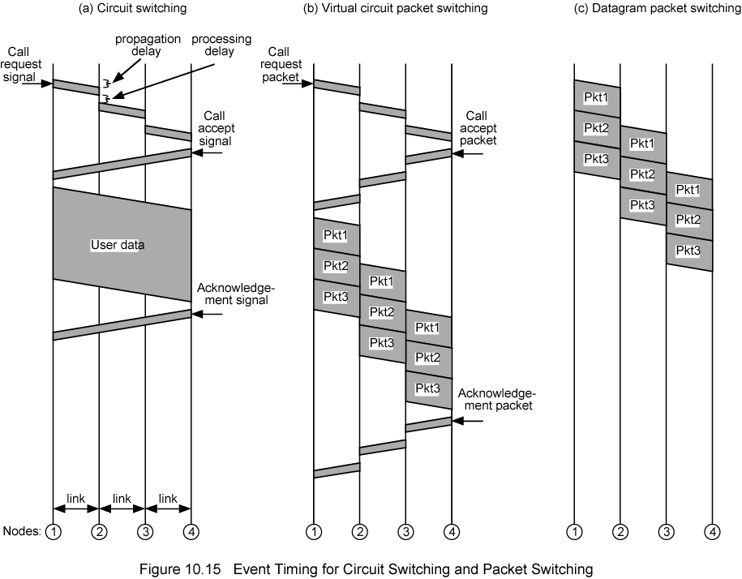
Event Timing

Slide 20
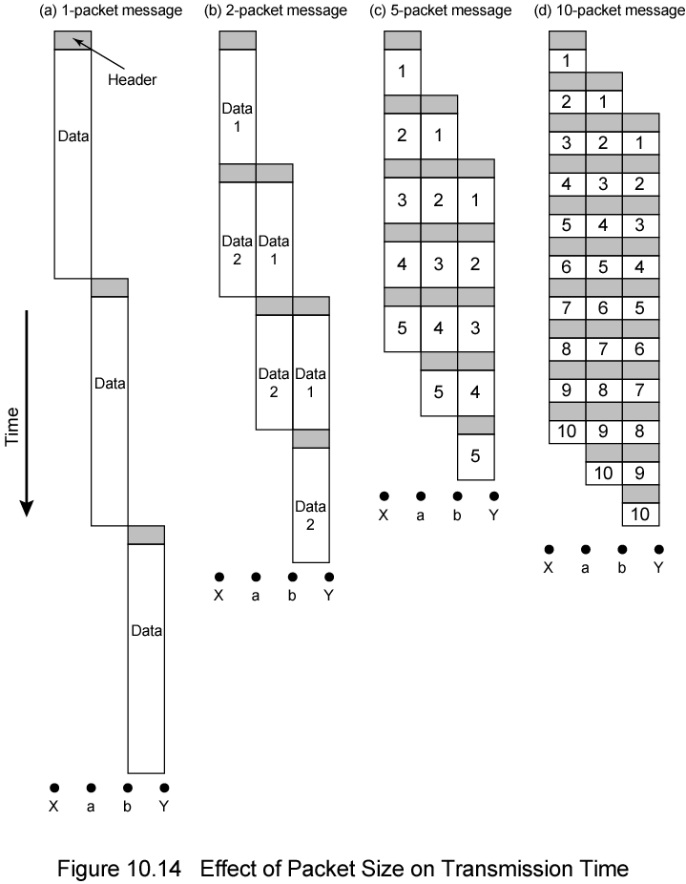
Fig. 18.1
Effect of packet size

Slide 21
Chapter 1: roadmap
1.1 What is the Internet?
1.2 Network edge
1.3 Network core
1.4 Physical media
1.5 Internet structure and ISPs
1.6 Delay & loss in packet-switched networks

Slide 22
Physical Media
Twisted Pair (TP)
two insulated copper wires
Category 3: traditional phone wires, 10 Mbps Ethernet
Category 5: 100Mbps Ethernet
Bit: propagates between transmitter/rcvr pairs
physical link: what lies between transmitter & receiver
guided media:
signals propagate in solid media: copper, fiber, coax
unguided media:
signals propagate freely, e.g., radio

Slide 23


Physical Media: coax, fiber
Fiber optic cable:
glass fiber carrying light pulses, each pulse a bit
high-speed operation:
high-speed point-to-point transmission (e.g., 5 Gps)
low error rate: repeaters spaced far apart ; immune to electromagnetic noise
Coaxial cable:
two concentric copper conductors
bidirectional
baseband:
single channel on cable
legacy Ethernet
broadband:
multiple channel on cable
HFC

Slide 24
Physical media: radio
signal carried in electromagnetic spectrum
no physical “wire”
bidirectional
propagation environment effects:
reflection
obstruction by objects
interference
Radio link types:
terrestrial microwave
e.g. up to 45 Mbps channels
LAN (e.g., Wifi)
2Mbps, 11Mbps
wide-area (e.g., cellular)
e.g. 3G: hundreds of kbps
satellite
up to 50Mbps channel (or multiple smaller channels)
270 msec end-end delay
geosynchronous versus low altitude

Slide 25
Chapter 1: roadmap
1.1 What is the Internet?
1.2 Network edge
1.3 Network core
1.4 Physical media
1.5 Internet structure and ISPs
1.6 Delay & loss in packet-switched networks

Slide 26
Internet structure: network of networks
Roughly hierarchical
At center: “tier-1” ISPs (e.g. AT&T), national/international coverage
A tier 1 network is a network that can reach every other network on the Internet without purchasing IP transit or paying for peering
Treat each other as equals
Tier-1 providers also interconnect at public network access points (NAPs)
Tier-1 providers interconnect (peer) privately
Tier 1 ISP
NAP
Tier 1 ISP
Tier 1 ISP

Slide 27
Internet structure: network of networks
“Tier-2” ISPs: smaller (often regional) ISPs
Connect to one or more tier-1 ISPs, possibly other tier-2 ISPs
Tier-2 ISPs also peer privately with each other, interconnect at NAP
Tier-2 ISP pays tier-1 ISP for connectivity to rest of Internet
tier-2 ISP is customer of
tier-1 provider
Tier-2 ISP
Tier-2 ISP
Tier 1 ISP
NAP
Tier 1 ISP
Tier 1 ISP
Tier-2 ISP
Tier-2 ISP
Tier-2 ISP

Slide 28
Internet structure: network of networks
“Tier-3” ISPs and local ISPs
last hop (“access”) network (closest to end systems)
local
ISP
Tier 3
ISP
local
ISP
local
ISP
local
ISP
Local and tier- 3 ISPs are customers of
higher tier ISPs
connecting them to rest of Internet
Tier-2 ISP
Tier-2 ISP
Tier 1 ISP
NAP
Tier 1 ISP
Tier 1 ISP
Tier-2 ISP
Tier-2 ISP
Tier-2 ISP
local
ISP
local
ISP
local
ISP
local
ISP

Slide 29
Internet structure: network of networks
a packet passes through many networks!
local
ISP
Tier 3
ISP
local
ISP
local
ISP
local
ISP
Tier-2 ISP
Tier-2 ISP
Tier 1 ISP
NAP
Tier 1 ISP
Tier 1 ISP
Tier-2 ISP
Tier-2 ISP
Tier-2 ISP
local
ISP
local
ISP
local
ISP
local
ISP

Slide 30
Chapter 1: roadmap
1.1 What is the Internet?
1.2 Network edge
1.3 Network core
1.4 Physical media
1.5 Internet structure and ISPs
1.6 Delay & loss in packet-switched networks

Slide 31
How do loss and delay occur?
packets queue in router buffers
packet arrival rate to link exceeds output link capacity
packets queue, wait for turn
packet being transmitted (delay)
A
B
packets queueing (delay)
free (available) buffers: arriving packets
dropped (loss) if no free buffers

Slide 32
Four sources of packet delay
1. nodal processing:
check bit errors
determine output link
2. queuing
Time waiting at output link for transmission
depends on congestion level of router
transmission
A
propagation
B
nodal
processing
queueing

Slide 33
Delay in packet-switched networks
3. Transmission delay:
R=link bandwidth (bps)
L=packet length (bits)
time to send bits into link = L/R
4. Propagation delay:
d = length of physical link
s = propagation speed in medium (~2x10⁸ m/sec)
propagation delay = d/s
Note: s and R are very different quantities!
transmission
A
propagation
B
nodal
processing
queueing

Slide 34
Nodal delay
d_{proc} = processing delay
typically a few microsecs or less
d_{queue} = queuing delay
depends on congestion
d_{trans} = transmission delay
= L/R, significant for low-speed links
d_{prop} = propagation delay
a few microsecs to hundreds of msecs

Slide 35
THANK YOU

